Slide 1

Lead Score Case Study
Anshul Khanna

Slide 2
Problem Statement
An X Education need help to select the most promising leads, i.e. the leads that are most likely to convert into paying customers.
The company requires us to build a model wherein you need to assign a lead score to each of the leads such that the customers with higher lead score have a higher conversion chance and the customers with lower lead score have a lower conversion chance.
The CEO has given a ballpark of the target lead conversion rate to be around 80%.

Slide 3
Business Objective
Build a model wherein assigning a lead score to each of the leads such that the customers with a higher lead score have a higher conversion chance and the customers with a lower lead score have a lower conversion chance.

Slide 4
Key Steps Involved:
Loading the Data.
Describing the Data.
Cleaning and Pre-processing the Data.
Exploratory Data Analysis.
Univariate analysis
Bivariate analysis
Model Building
Train Test Split
Train the Data
Test the Data
Prediction

Slide 5
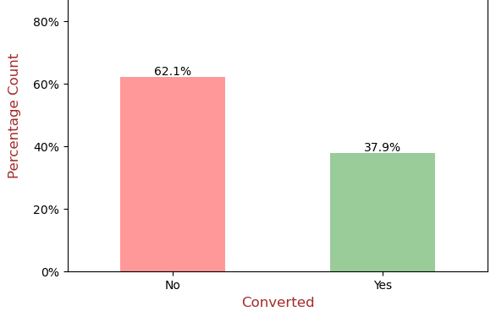
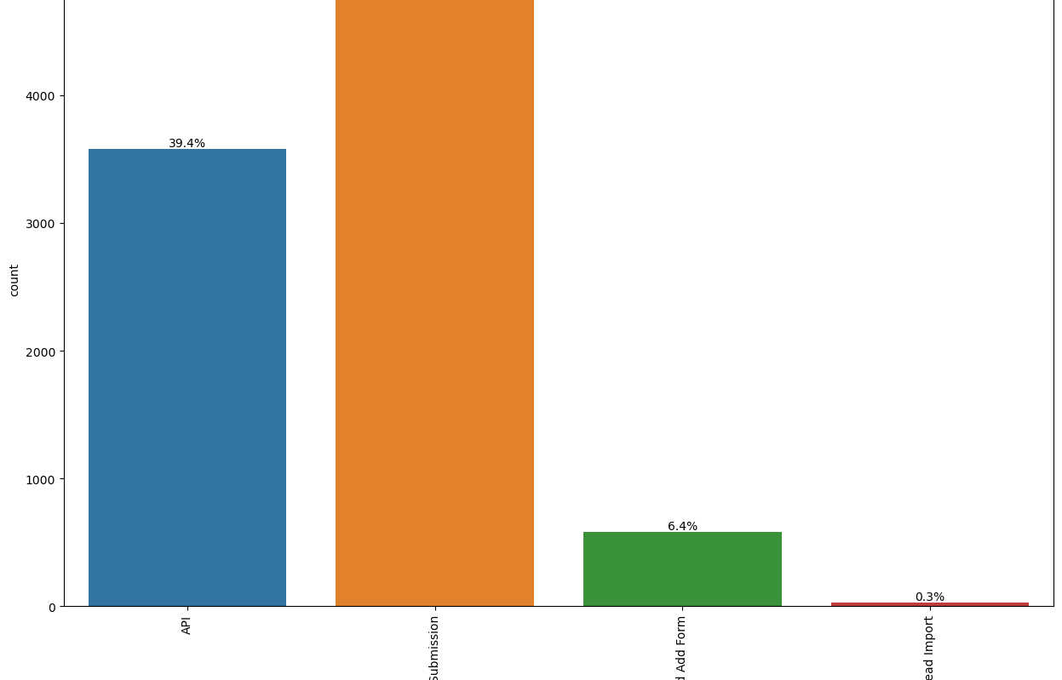
Leads

Slide 6
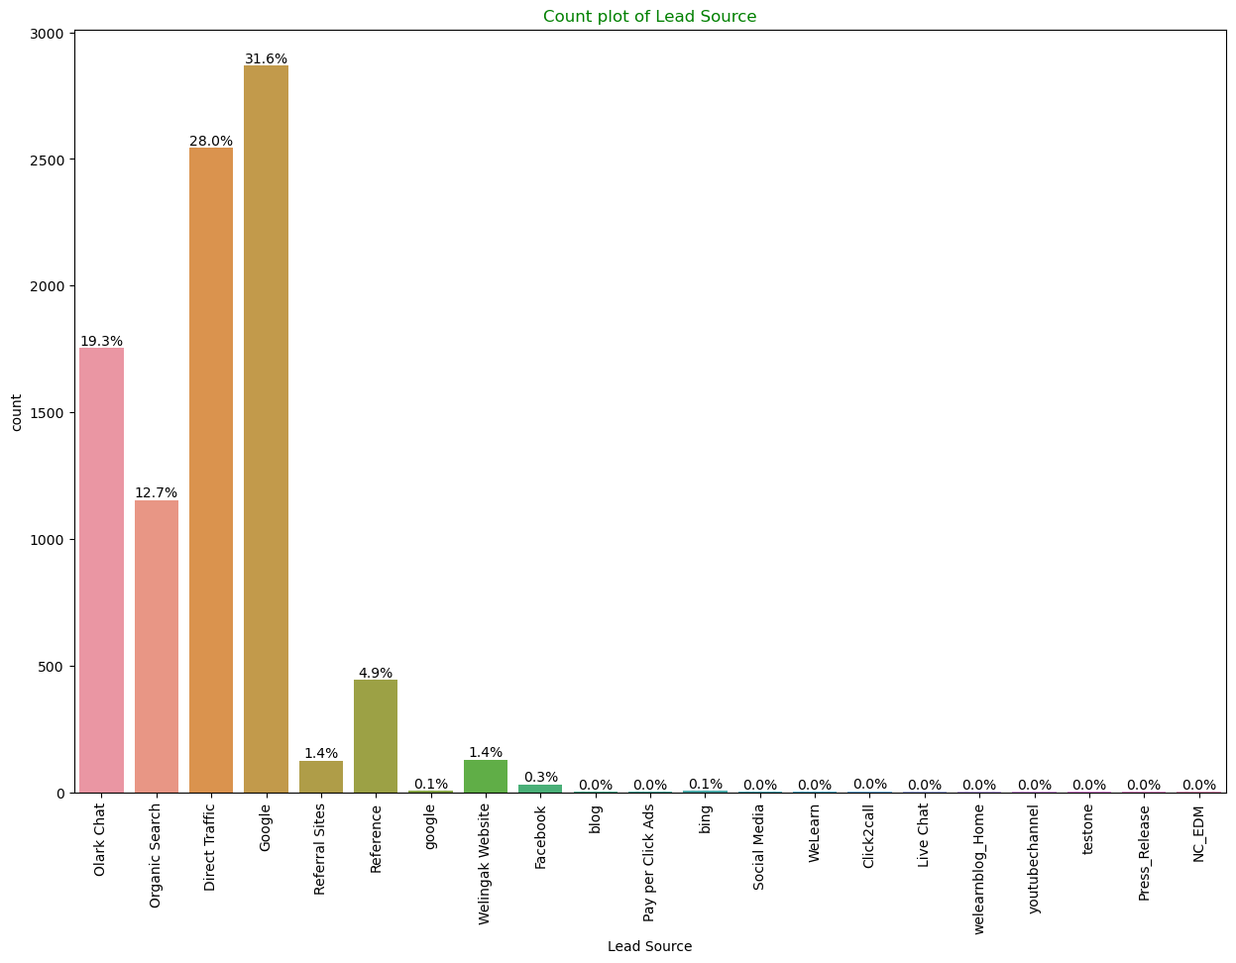
Lead Score

Slide 7
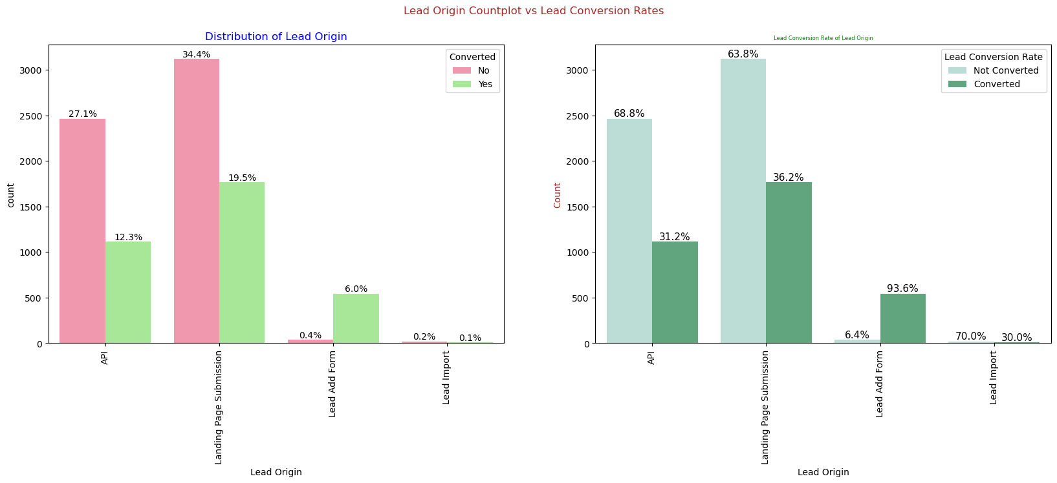

Slide 8
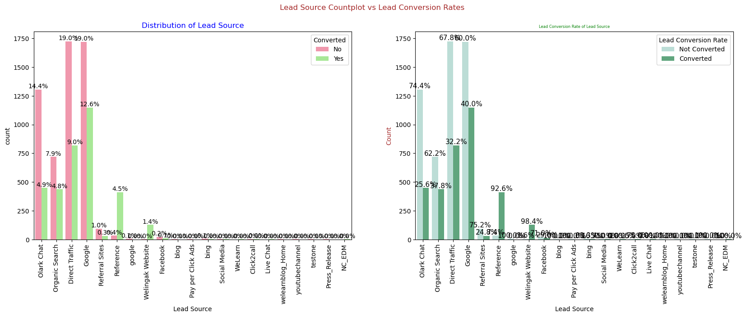

Slide 9
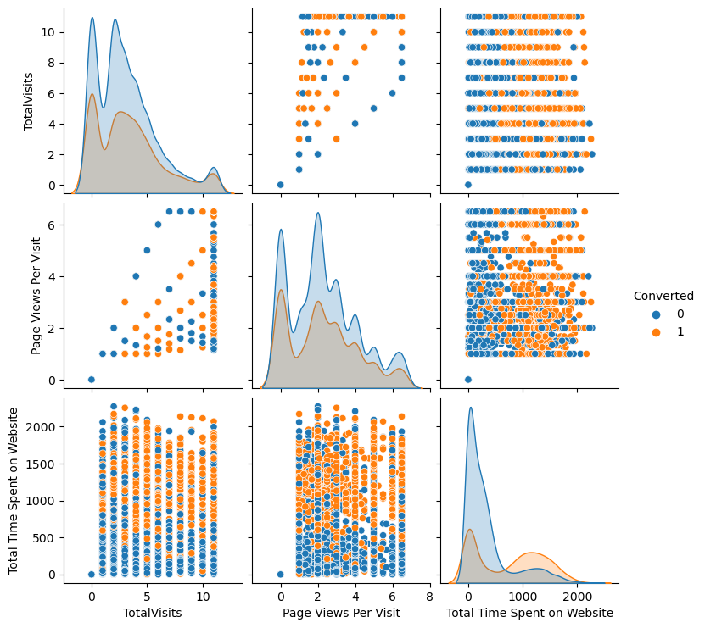
Converted Leads

Slide 10
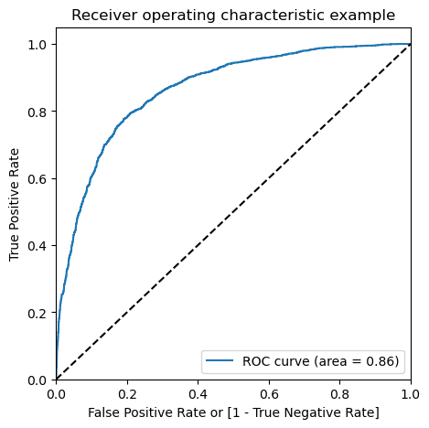
ROC Curve

Slide 11
Conclusion
It was found that the variables that mattered the most in the potential buyers are :
Lead Origin
Lead Source
Total no. of visits.
When the last activity was:
SMS
Olark chat conversation
When their current occupation is as a working professional.
Keeping these in mind the X Education can flourish as they have a very high chance to get almost all the potential buyers to change their mind and buy their courses.

